Slide 1

Programming in Java
Topic: Collections

Slide 2
Contents
Introduction
List: ArrayList
Set: TreeSet
Map: HashMap
Deque
Ordering Collections: Comparable and Comparator

Slide 3
Introduction
A collection is simply an object that groups multiple elements into a single unit.
Collections are used to store, retrieve, manipulate, and communicate aggregate data.
java.util package contains all the collection classes and interfaces.

Slide 4
Collection Framework
A collections framework is a unified architecture for representing and manipulating collections.
It is a collection of classes and interfaces.
At the top of collection framework hierarchy, there is an interface, Collection.

Slide 5
Advantages of Collections
Reduces programming effort
Increases program speed and quality
Allows interoperability among unrelated APIs

Slide 6
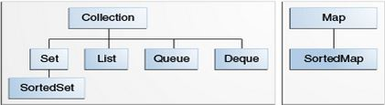
Collection Interfaces
The Java Collections Framework supports two types of containers:
Collection: for storing a collection of elements
Map: for storing key/value pairs

Slide 7
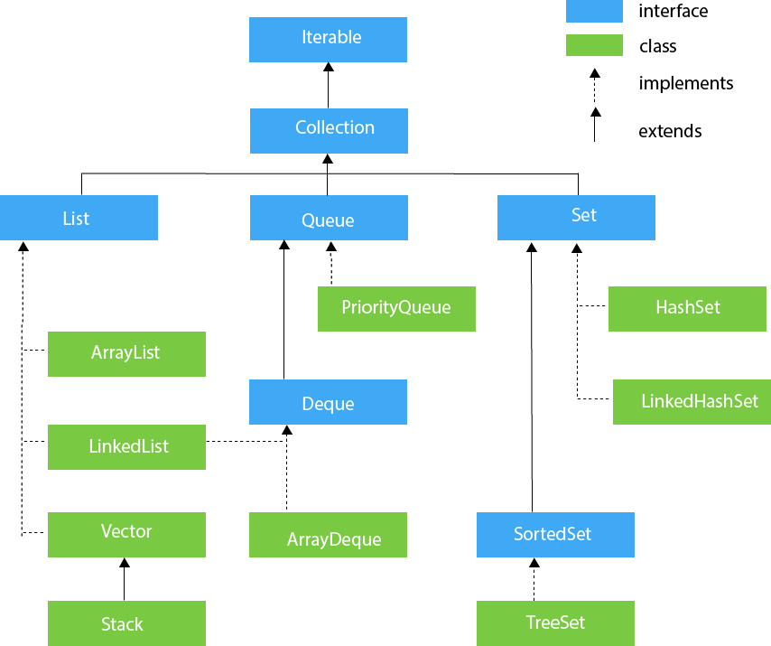
Hierarchy of Collections Framework

Slide 8
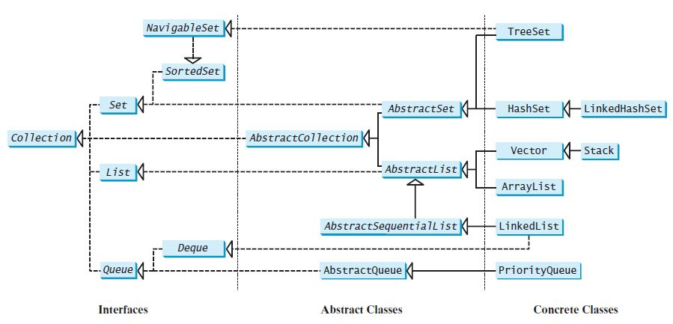

Slide 9
Collection Interfaces
Sets store a group of non-duplicate elements.
Lists store an ordered collection of elements.
Queues store objects that are processed in first-in, first-out fashion.
Maps are efficient data structures for quickly searching an element using a key.

Slide 10
The AbstractCollection class provides partial implementation for the Collection interface.
It implements all the methods in Collection except the size() and iterator() methods.

Slide 11
Collection
Interface

Slide 12
Methods of Collection Interface
boolean add(Object o)
Appends the specified element o to the end of the collection.
boolean addAll(Collection c )
Appends all of the elements in the specified collection to the end of the collection.

Slide 13
boolean contains(Object o)
Returns true if this list contains the specified element.
boolean containsAll(Collection c)
Returns true if this collection contains all the elements in c.

Slide 14
boolean remove(Object o)
Removes the object from this collection.
boolean removeAll(Collection c)
Removes all the elements in c from this collection.
boolean retainAll(Collection c)
Retains the elements that are both in c and in this collection.

Slide 15
void clear()
Removes all of the elements from the collection.
boolean isEmpty()
Returns true if this collection contains no elements.
int size()
Returns the number of elements in the collection.

Slide 16
object [] toArray()
Returns an array of Object for the elements in the collection.
Iterator iterator()
Returns the iterator object for the invoking collection.
        I

Slide 17
Iterators

Slide 18
Iterator
There is an Iterable interface at the top of Collection hierarchy.
The Collection interface extends the java.lang.Iterable interface.
It defines a method which returns an Iterator object for the elements of Collection.
Iterator iterator()
Iterator object is used to traverse the elements in a collection.

Slide 19
Methods of Iterator Interface
boolean hasNext()
Returns true if this iterator has more elements to traverse.
Object next()
Returns the next element from this iterator.
void remove()
Removes the last element obtained using the next method.

Slide 20
ListIterator

Slide 21
ListIterator
ListIterator is derived from Iterator interface and comes with more methods than Iterator.
ListIterator can be used to traverse for List type Objects.
Allows to traverse in both the directions.

Slide 22
ListIterator
A ListIterator has no current element; its cursor position always lies between the element that would be returned by a call to previous() and the element that would be returned by a call to next().
The remove() and set(Object) methods are not defined in terms of the cursor position; they are defined to operate on the last element returned by a call to next() or previous().

Slide 23
ListIterator Methods
public abstract boolean hasPrevious()
public abstract Object previous();
public abstract int nextIndex();
public abstract int previousIndex();
public abstract void set(Object);
public abstract void add(Object);

Slide 24
list Interface

Slide 25
List
The List interface extends the Collection interface.
It defines a collection for storing elements in a sequential order.
It define an ordered collection with duplicates allowed.
ArrayList , Vector and LinkedList are the sub-classes of List interface.

Slide 26
Methods of List Interface
boolean add(int index, Object o )
boolean addAll(int index, Collection c )
Object remove(int index)
Object get(int index)
Object set(int index, Object o)
int indexOf(Object o)
int lastIndexOf(Object o)
ListIterator listIterator()
ListIterator listIterator(int start_index)
List subList(int start_index, int end_index): returns a sublist from start_index to end_index-1

Slide 27
Sub-classes of List
ArrayList
LinkedList
Vector
Stack

Slide 28
ArrayList

Slide 29
ArrayList
The ArrayList class extends AbstractList and implements the List interface.
Defined in java.util package.
ArrayList supports dynamic arrays that can grow as needed.
Array lists are created with an initial size.
When this size is exceeded, the collection is automatically enlarged.
When objects are removed, the array may be shrunk.

Slide 30
ArrayList Constructors
T he ArrayList class supports three constructors.
ArrayList() : creates an empty array list with an initial capacity sufficient to hold 10 elements.
ArrayList(int capacity) : creates an array list that has the specified initial capacity.
ArrayList(Collection c) : creates an array list that is initialized with the elements of the collection c.

Slide 31
Methods of ArrayList
boolean add(Object o)
Appends the specified element to the end of this list.
void add(int index, Object element)
Inserts the specified element at the specified position index in this list.
Throws IndexOutOfBoundsException if the specified index is out of range.

Slide 32
boolean addAll(Collection c )
Appends all of the elements in the specified collection to the end of this list.
Throws NullPointerException if the specified collection is null.
boolean addAll(int index, Collection c )
Inserts all of the elements of the specified collection into this list, starting at the specified position.
Throws NullPointerException if the specified collection is null.

Slide 33
Object remove(int index)
Removes the element at the specified position in this list.
Object remove(Object o)
Removes the element o from this list.
Object clone()
Returns a shallow copy of this ArrayList.
int size()
Returns the number of elements in the list.
void clear()
Removes all of the elements from this list.

Slide 34
boolean contains(Object o)
Returns true if this list contains the specified element.
Object get(int index)
Returns the element at the specified position in this list.
int indexOf(Object o)
Returns the index in this list of the first occurrence of the specified element, or -1 if the List does not contain the element.
int lastIndexOf(Object o)
Returns the index in this list of the last occurrence of the specified element, or -1.

Slide 35
void ensureCapacity(int minCapacity)
Increases the capacity of this ArrayList instance, if necessary, to ensure that it can hold at least the number of elements specified by the minimum capacity argument.
Object set(int index, Object element)
Replaces the element at the specified position in this list with the specified element.
Throws IndexOutOfBoundsException if the specified index is out of range (index < 0 || index >= size()).

Slide 36
void trimToSize()
Trims the capacity of this ArrayList instance to be the list’s current size.

Slide 37
Set Interface

Slide 38
Set Interface
A set is an efficient data structure for storing and processing non-duplicate elements.
Set does not introduce new methods or constants.
The sub-classes of Set (HashSet, TreeSet & LinkedHashSet) ensure that no duplicate elements can be added to the set.

Slide 39
Set Interface
The AbstractSet class provides implementations for the equals() method and the hashCode().
The hash code of a set is the sum of the hash codes of all the elements in the set.
The size() and iterator() are not implemented in the AbstractSet class.

Slide 40
TREESet

Slide 41
TreeSet
TreeSet implements the NavigableSet interface.
We can add objects into a tree set as long as they can be compared with each other.
Access and retrieval times are quite fast.
TreeSet implements the SortedSet interface. So, duplicate values are not allowed.
Objects in a TreeSet are stored in a sorted and ascending order.
TreeSet does not preserve the insertion order of elements but elements are sorted by keys.
Null values are not accepted by TreeSet

Slide 42
TreeSet
Constructor:
TreeSet()
TreeSet(Collection c)
TreeSet(Comparator c)

Slide 43
Implementing TreeSet[Example 1]
import java.util.*;
public class Main {
public static void main(String args[]){
Set<Integer> tree = new TreeSet<Integer>();
tree.add(3);
tree.add(1);
tree.add(2);
System.out.println("treeSet : "+tree);
}
}
Output:
treeSet: [1,2,3]

Slide 44
Example 2
import java.util.*;
public class Main{
public static void main(String args[]){
//Creating and adding elements
TreeSet<String> al=new TreeSet<String>();
al.add("Ravi");
al.add("Vijay");
al.add("Ravi");
al.add("Ajay");
//Traversing elements
Iterator<String> itr=al.iterator();
while(itr.hasNext()){
System.out.println(itr.next());
}
}
}

Slide 45
Example 3
import java.util.*;
public class Main{
public static void main(String args[]){
TreeSet<String> set=new TreeSet<String>();
set.add("Ravi");
set.add("Vijay");
set.add("Ajay");
System.out.println("Traversing element through Iterator in descending order");
Iterator i=set.descendingIterator();
while(i.hasNext())
{
System.out.println(i.next());
}
}
}

Slide 46
Example 4
import java.util.*;
public class Main{
public static void main(String args[]){
TreeSet<Integer> set=new TreeSet<Integer>();
set.add(24);
set.add(66);
set.add(12);
set.add(15);
System.out.println("Lowest Value: "+set.pollFirst());
System.out.println("Highest Value: "+set.pollLast());
System.out.println(set);
}
}

Slide 47
Example 5
// Java code to demonstrate
// the working of TreeSet
import java.util.*;
public class Main {
public static void main(String[] args)
{
TreeSet<String> ts= new TreeSet<String>();
// Elements are added using add() method
ts.add("AA");
ts.add("BB");
ts.add("CC");
System.out.println("Tree Set is " + ts);
String check = "BB";
// Check if the above string exists in the treeset or not
System.out.println("Contains " + check + " " + ts.contains(check));
// Print the first element in the TreeSet
System.out.println("First Value " + ts.first());
// Print the last element in the TreeSet
System.out.println("Last Value " + ts.last());
String val = "BB";
// Find the values just greater and smaller than the above string
System.out.println("Higher " + ts.higher(val));
System.out.println("Lower " + ts.lower(val));
}
}

Slide 48
Example 6[Iterating through TreeSet]
// Java code to demonstrate the working of TreeSet
import java.util.*;
class TreeSetDemo {
public static void main(String[] args)
{
TreeSet<String> ts= new TreeSet<String>();
// Elements are added using add() method
ts.add(“AA");
ts.add(“BB");
ts.add(“CC");
// Iterating though the TreeSet
for (String value : ts)
System.out.print(value+ ", ");
System.out.println();
}
}

Slide 49
Comparator Interface
java.util.Comparator interface provides two abstract methods:
public interface Comparator<T>
{
public abstract int compare(T ob1, T ob2);
public abstract boolean equals(java.lang.Object);
…
}

Slide 50
Comparable Interface
java.lang.Comparable interface provides only one abstract method:
public interface Comparable<T>
{
public abstract int compareTo(T ob);
}

Slide 51
Implementing TreeSet with Comparator sorting in descending order
import java.util.*;
public class Main {
public static void main(String args[]){
Set<Integer> tree = new TreeSet<Integer>(new Comparator<Integer>() {
public int compare(Integer o1, Integer o2) {
return o2.compareTo(o1);
}
});
tree.add(3);
tree.add(1);
tree.add(2);
System.out.println("treeSet : "+tree);
}
}

Slide 52
Implementing TreeSet with Custom Objects using Comparator
import java.util.*;
class Employee{
String name;
String id;
public Employee(String name, String id) {
this.name = name;
this.id = id;
}
public String toString() {
return "Employee{" + "name=" + name + ", id=" + id + '}';
}
}

Slide 53
Implementing TreeSet with Custom Objects using Comparator
public class Main {
public static void main(String...a){
Employee emp1=new Employee("Smith","4");
Employee emp2=new Employee("Paul","2");
Employee emp3=new Employee("Charles","1");
Set<Employee> treeSet = new TreeSet<Employee>(new Comparator<Employee>()
{
public int compare(Employee o1, Employee o2)
{ return o1.name.compareTo(o2.name); }
});
treeSet.add(emp1);treeSet.add(emp2);treeSet.add(emp3);
System.out.println("treeSet : "+treeSet);
}}

Slide 54
DEQue

Slide 55
Deque Interface
Deque supports element insertion and removal at both ends.
The name deque is short for “double-ended queue” and is usually pronounced “deck.”
The Deque interface extends Queue with additional methods for inserting and removing elements from both ends of the queue.
The methods addFirst(e), removeFirst(), addLast(e), removeLast(), getFirst(), and getLast() are defined in the Deque interface.

Slide 56
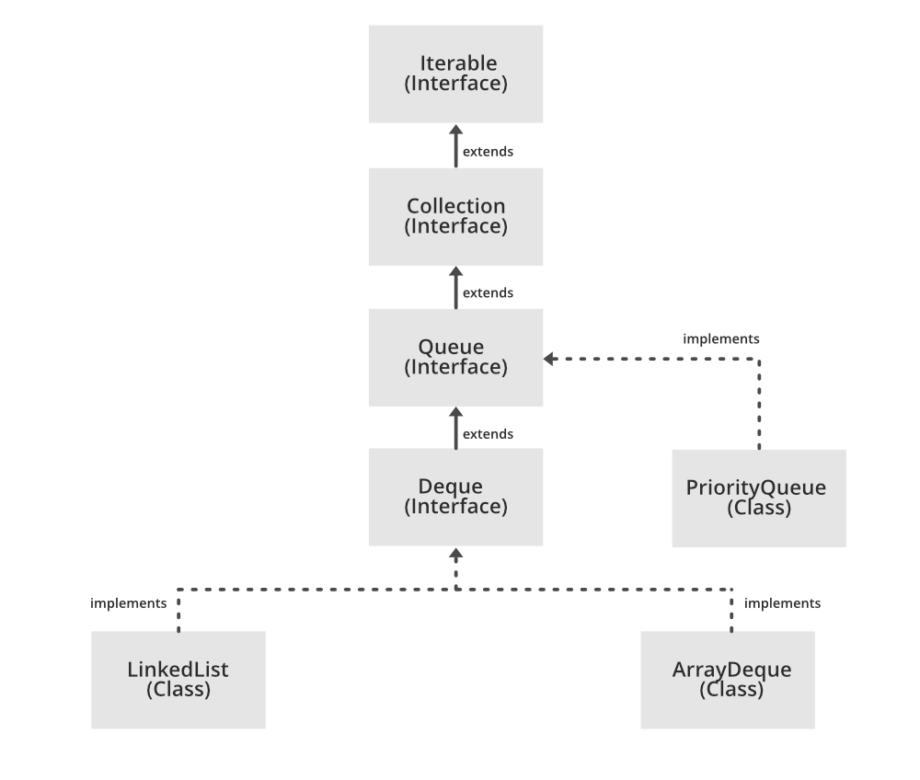
Hierarchy of classes

Slide 57
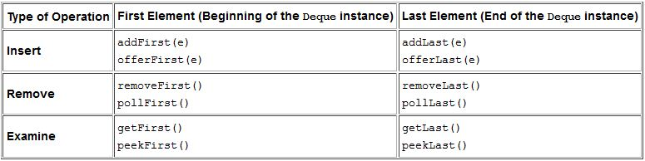
Deque Methods

Slide 58
Methods Description
addFirst():Inserts the specified element at the front of this deque if it is possible to do so immediately without violating capacity restrictions. When using a capacity-restricted deque, it is generally preferable to use method offerFirst(E).
offerFirst():Inserts the specified element at the front of this deque unless it would violate capacity restrictions. When using a capacity-restricted deque, this method is generally preferable to the addFirst(E) method, which can fail to insert an element only by throwing an exception.

Slide 59
removeFirst():Retrieves and removes the first element of this deque. This method differs from pollFirst only in that it throws an exception if this deque is empty.
Throws:
NoSuchElementException - if this deque is empty
pollFirst():Retrieves and removes the first element of this deque, or returns null if this deque is empty.

Slide 60
addLast():Inserts the specified element at the end of this deque if it is possible to do so immediately without violating capacity restrictions. When using a capacity-restricted deque, it is generally preferable to use method offerLast(E).
offerLast():Inserts the specified element at the end of this deque unless it would violate capacity restrictions. When using a capacity-restricted deque, this method is generally preferable to the addLast(E) method, which can fail to insert an element only by throwing an exception.

Slide 61
removeLast()
Retrieves and removes the last element of this deque. This method differs from pollLast only in that it throws an exception if this deque is empty.
pollLast()
Retrieves and removes the last element of this deque, or returns null if this deque is empty.

Slide 62
Insert Methods
The addfirst and offerFirst methods insert elements at the beginning of the Deque instance.
The methods addLast and offerLast insert elements at the end of the Deque instance.
When the capacity of the Deque instance is restricted, the preferred methods are offerFirst and offerLast because addFirst might fail to throw an exception if it is full.

Slide 63
Remove Methods
removeFirst and pollFirst methods remove elements from the beginning of the Deque.
The removeLast and pollLast methods remove elements from the end.
The methods pollFirst and pollLast return null if the Deque is empty whereas the methods removeFirst and removeLast throw an exception if the Deque instance is empty.

Slide 64
Retrieve Methods
getFirst and peekFirst retrieve the first element but don’t remove the value from the Deque.
Similarly, getLast and peekLast retrieve the last element.
The methods getFirst and getLast throw an exception if the deque instance is empty whereas the methods peekFirst and peekLast return NULL.

Slide 65
Deque Implementation
The ArrayDeque class is the resizable array implementation of the Deque interface, whereas the LinkedList class is the list implementation.
The LinkedList is more flexible than the ArrayDeque as null elements are allowed in the LinkedList implementation but not in ArrayDeque.
ArrayDeque is more efficient than the LinkedList for add and remove operation at both ends.
The best operation in a LinkedList implementation is removing the current element during the iteration.

Slide 66
ArrayDeque Constructors
ArrayDeque()
Constructs an empty array deque with an initial capacity sufficient to hold 16 elements.
ArrayDeque(Collection<? extends E> c)
Constructs a deque containing the elements of the specified collection, in the order they are returned by the collection's iterator.
ArrayDeque(int numElements)
Constructs an empty array deque with an initial capacity sufficient to hold the specified number of elements.

Slide 67
LinkedList Constructors
LinkedList()
Constructs an empty LinkedList.
LinkedList(Collection<? extends E> c)
Constructs a list containing the elements of the specified collection, in the order they are returned by the collection's iterator.

Slide 68
Example 1
// Java program to demonstrate the working of a Deque in Java
import java.util.*;
public class Main {
public static void main(String[] args)
{
Deque<String> deque= new LinkedList<String>();
// We can add elements to the queue in various ways
// Add at the last
deque.add("Element 1 (Tail)");
// Add at the first
deque.addFirst("Element 2 (Head)");
// Add at the last
deque.addLast("Element 3 (Tail)");
// Add at the first
deque.push("Element 4 (Head)");
// Add at the last
deque.offer("Element 5 (Tail)");
// Add at the first
deque.offerFirst("Element 6 (Head)");
System.out.println(deque + "\n");
// We can remove the first element or the last element.
deque.removeFirst();
deque.removeLast();
System.out.println("Deque after removing "+ "first and last: "+ deque);
}
}

Slide 69
Output:
[Element 6 (Head), Element 4 (Head), Element 2 (Head), Element 1 (Tail), Element 3 (Tail), Element 5 (Tail)]
Deque after removing first and last:
[Element 4 (Head), Element 2 (Head), Element 1 (Tail), Element 3 (Tail)]

Slide 70
Example 2
// Java program to demonstrate the
// addition of elements in deque
import java.util.*;
public class Main {
public static void main(String[] args)
{
// Initializing an deque
Deque<String> dq= new ArrayDeque<String>();
// add() method to insert
dq.add("AA");
dq.addFirst("BB");
dq.addLast("CC");
System.out.println(dq);
}
}

Slide 71
Example 3
// Java program to demonstrate the removal of elements in deque
import java.util.*;
public class Main {
public static void main(String[] args)
{
// Initializing an deque
Deque<String> dq= new ArrayDeque<String>();
// add() method to insert
dq.add("ABC");
dq.addFirst("PQR");
dq.addLast("STU");
System.out.println(dq);
System.out.println(dq.pop());
System.out.println(dq.pollFirst());
System.out.println(dq.pollLast());
System.out.println(dq);
}
}

Slide 72
Example 4
// Java program to demonstrate the iteration of elements in deque
import java.util.*;
public class Main {
public static void main(String[] args)
{
// Initializing an deque
Deque<String> dq= new ArrayDeque<String>();
// add() method to insert
dq.add("ABC");
dq.addFirst("PQR");
dq.addLast("STU");
dq.add("BB");
for (Iterator itr = dq.iterator();
itr.hasNext();) {
System.out.print(itr.next() + " ");
}
System.out.println();
for (Iterator itr = dq.descendingIterator();
itr.hasNext();) {
System.out.print(itr.next() + " ");
}
}
}

Slide 73
MAP Interface

Slide 74
MAP Interface
A map is a container object that stores a collection of key/value pairs.
Keys are like indexes in List but in Map, the keys can be any objects.
A map cannot contain duplicate keys.
Each key maps to one value.
A key and its corresponding value form an entry stored in a map.

Slide 75
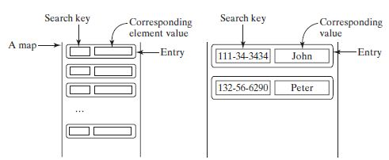
MAP

Slide 76
MAP Methods
int size()
void clear()
boolean isEmpty()
V put( K key, V value)
void putAll( m: Map<? extends K,? extendsV>)
boolean containsKey (Object key)
boolean containsValue(Object value)
V get(Object key)
Set<K> keySet()
V remove( Object key)
Collection <V> values()
Set<Map.Entry<K,V>> entrySet()

Slide 77
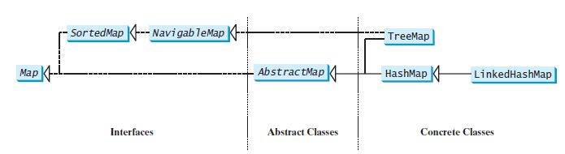
MAP Class Hierarchy

Slide 78
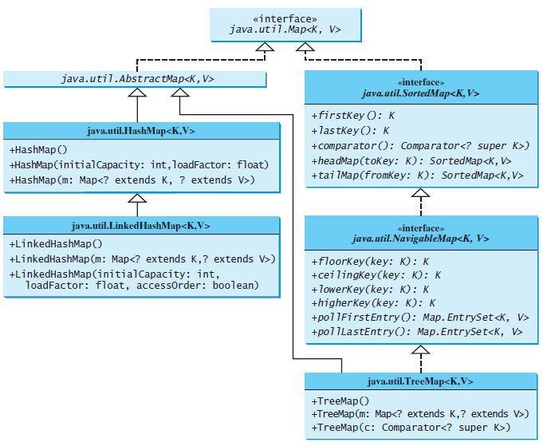
MAP
Ravi Kant Sahu, Asst. Professor @ Lovely Professional University, Punjab (India)

Slide 79
HashMap
The HashMap class is efficient for locating a value, inserting an entry, and deleting an entry.
The entries in a HashMap are not ordered.
public class HashMap<K, V> extends AbstractMap<K, V> implements Map<K, V>, Cloneable, Serializable

Slide 80
More features of HashMap
HashMap is a part of java.util package.
HashMap extends an abstract class AbstractMap which also provides an incomplete implementation of Map interface.
HashMap doesn’t allow duplicate keys but allows duplicate values. That means A single key can’t contain more than 1 value but more than 1 key can contain a single value.
HashMap allows null key also but only once and multiple null values.

Slide 81
HashMap
Constructors:
HashMap()
Constructs an empty HashMap with the default initial capacity (16)
HashMap(int initialCapacity)
Constructs an empty HashMap with the specified initial capacity
HashMap(Map<? extends K,? extends V> m)
Constructs a new HashMap with the same mappings as the specified Map.

Slide 82
Example 1
// Java program to demonstrate the HashMap() constructor
import java.util.*;
public class Main {
public static void main(String args[])
{
// No need to mention the Generic type twice
HashMap<Integer, String> hm1 = new HashMap<>();
// Initialization of a HashMap using Generics
HashMap<Integer, String> hm2= new HashMap<Integer, String>();
// Add Elements using put method
hm1.put(1, "one");
hm1.put(2, "two");
hm1.put(3, "three");
hm2.put(4, "four");
hm2.put(5, "five");
hm2.put(6, "six");
System.out.println("Mappings of HashMap hm1 are : "+ hm1);
System.out.println("Mapping of HashMap hm2 are : "+ hm2);
}
}

Slide 83
Example 2
// Java program to demonstrate the HashMap(int initialCapacity) constructor
import java.util.*;
public class Main {
public static void main(String args[])
{
// No need to mention the Generic type twice
HashMap<Integer, String> hm1 = new HashMap<>(10);
// Initialization of a HashMap using Generics
HashMap<Integer, String> hm2= new HashMap<Integer, String>(2);
// Add Elements using put method
hm1.put(1, "one");
hm1.put(2, "two");
hm1.put(3, "three");
hm2.put(4, "four");
hm2.put(5, "five");
hm2.put(6, "six");
System.out.println("Mappings of HashMap hm1 are : "+ hm1);
System.out.println("Mapping of HashMap hm2 are : "+ hm2);
}
}

Slide 84
Example 3
// Java program to demonstrate the HashMap(Map map) Constructor
import java.util.*;
public class Main {
public static void main(String args[])
{
// No need to mention the Generic type twice
Map<Integer, String> hm1 = new HashMap<>();
// Add Elements using put method
hm1.put(1, "one");
hm1.put(2, "two");
hm1.put(3, "three");
// Initialization of a HashMap using Generics
HashMap<Integer, String> hm2= new HashMap<Integer, String>(hm1);
System.out.println("Mappings of HashMap hm1 are : "+ hm1);
System.out.println("Mapping of HashMap hm2 are : "+ hm2);
}
}

Slide 85
Example 4
// Java program to add elements to the HashMap
import java.util.*;
public class Main {
public static void main(String args[])
{
// No need to mention the Generic type twice
HashMap<Integer, String> hm1 = new HashMap<>();
// Initialization of a HashMap using Generics
HashMap<Integer, String> hm2= new HashMap<Integer, String>();
// Add Elements using put method
hm1.put(1, "One");
hm1.put(2, "two");
hm1.put(3, "three");
hm2.put(1, "AA");
hm2.put(2, "BB");
hm2.put(3, "CC");
System.out.println("Mappings of HashMap hm1 are : "+ hm1);
System.out.println("Mapping of HashMap hm2 are : "+ hm2);
}
}

Slide 86
Example 5
// Java program to illustrate Java.util.HashMap
import java.util.HashMap;
public class Main {
public static void main(String[] args)
{
// Create an empty hash map
HashMap<String, Integer> map = new HashMap<>();
// Add elements to the map
map.put("ABC", 10);
map.put("PQR", 30);
map.put("STU", 20);
// Print size and content
System.out.println("Size of map is:- "+ map.size());
System.out.println(map);
// Check if a key is present and if present, print value
if (map.containsKey("ABC")) {
Integer a = map.get("ABC");
System.out.println("Value for key"+ " \"ABC\" is:- " + a);
}
}
}

Slide 87
Example 6
// Java program to remove elements from HashMap
import java.util.*;
public class Main{
public static void main(String args[])
{
// Initialization of a HashMap
Map<Integer, String> hm= new HashMap<Integer, String>();
// Add elements using put method
hm.put(1, "AA");
hm.put(2, "BB");
hm.put(3, "CC");
hm.put(4, "DD");
// Initial HashMap
System.out.println("Mappings of HashMap are : "+ hm);
// remove element with a key using remove method
hm.remove(4);
// Final HashMap
System.out.println("Mappings after removal are : "+ hm);
}
}

Slide 88
Example 7
// Java program to traversal a Java.util.HashMap
import java.util.HashMap;
import java.util.Map;
public class Main {
public static void main(String[] args)
{
// initialize a HashMap
HashMap<String, Integer> map = new HashMap<>();
// Add elements using put method
map.put("AA", 10);
map.put("BB", 30);
map.put("CC", 20);
// Iterate the map using for-each loop
for (Map.Entry<String, Integer> e : map.entrySet())
System.out.println("Key: " + e.getKey() + " Value: " + e.getValue());
}
}

Slide 89
Example 8(More methods)
// Java program to traversal a Java.util.HashMap
import java.util.*;
public class Main {
public static void main(String[] args)
{
// initialize a HashMap
HashMap<String, Integer> map = new HashMap<>();
// Add elements using put method
map.put("AA", 10);
map.put("BB", 30);
map.put("CC", 20);
HashMap<String, Integer> map1 = new HashMap<>();
map1.putAll(map);
System.out.println(map1);
System.out.println(map.get("AA"));
Collection c=map.values();
for(Object x:c)
System.out.println(x);
Set s=map.keySet();
for(Object x:s)
System.out.println(x);
}
}

Slide 90
Q1
Which of these packages contain all the collection classes?
a) java.lang
b) java.util
c) java.net
d) java.awt
Notes:
b

Slide 91
Q2
Which of these methods deletes all the elements from invoking collection?
a) clear()
b) reset()
c) delete()
d) refresh()
Notes:
a

Slide 92
Q3
What is Collection in Java?
a) A group of objects
b) A group of classes
c) A group of interfaces
d) None of the mentioned
Notes:
a

Slide 93
Q4
The collection interface
A.extends Collections class
B.extends Iterable interface
C.implements Serializable interface
D.implements Traversable interface
Notes:
B

Slide 94
Q5
The collection is a ____________
A.framework and interface
B.framework and class
C.only interface
D.only class
Notes:
A

Slide 95
Q6
List, Set and Queue __________ Collection.
A.extends
B.implements
C.both of the above
D.none of the above
Notes:
A

Slide 96
Q7
Arraylist, Linkedlist and vector are all ___________
A.interfaces
B.enums
C.classes
D.Depends on implementation
Notes:
C

Slide 97
Q8
Which of the following is true?
1. Iterator can traverse in both forward and backward directions.
2. ListIterator can traverse in both forward and backward directions.
A.Only 1
B.Only 2
C.Both 1 & 2
D.None of the above
Notes:
B

Slide 98
Q9
Which of the following interface doesn't extend collection interface?
A.List
B.Set
C.Map
D.Queue
Notes:
C

Slide 99
Q10
The default capacity of a ArrayList is:
a.12
b.16
c.1
d.10
Notes:
d

Slide 100
Q11
Deque and Queue are derived from:
a.AbstractList
b.Collection
c.AbstractCollection
d.List
Notes:
b

Slide 101
Q12
nextIndex() and previousIndex() are methods of which interface?
a.IndexIterator
b.Iterator
c.ListIterator
d.NextPreviousIterator
Notes:
C

Slide 102
Q13
Which of these allows duplicate elements?
a.Set
b.List
c.All
d.None
Notes:
b

Slide 103


